Slide 1
Discrete Mathematics
(BCSC1010)
Module 1
Combinations

Slide 2
COMBINATIONS
Combination is a way of selecting items from a collection, such that (unlike permutations), irrespective of their arrangement.
Or
Selection of objects from a group of objects where the order of selection does not matter.

Slide 3
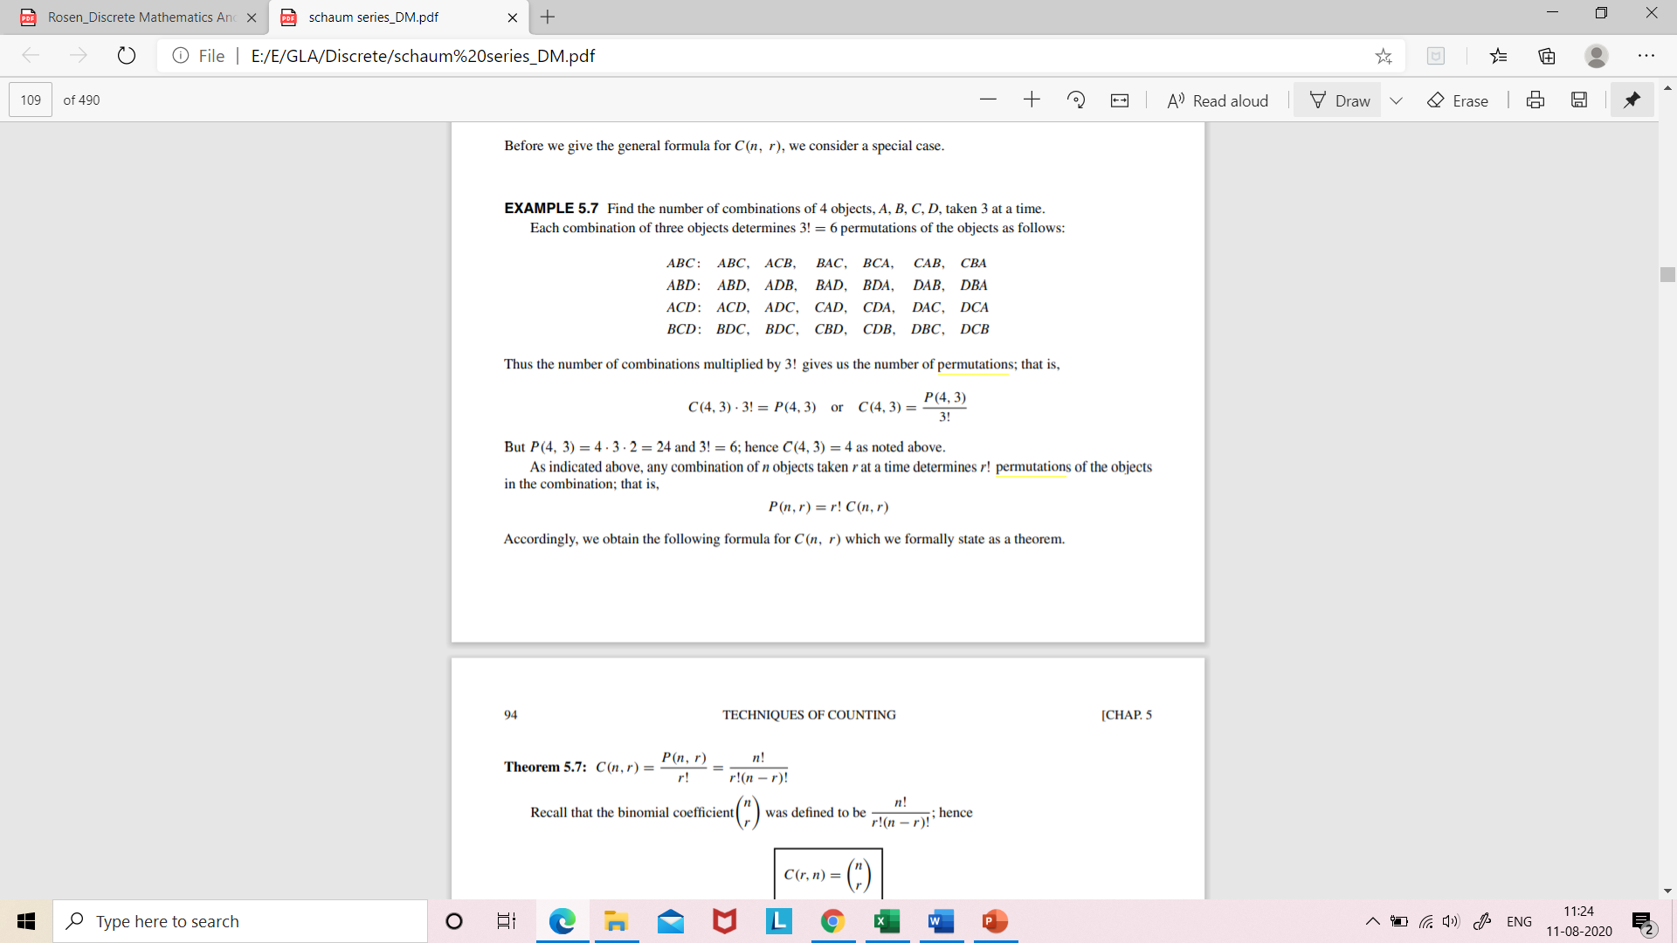
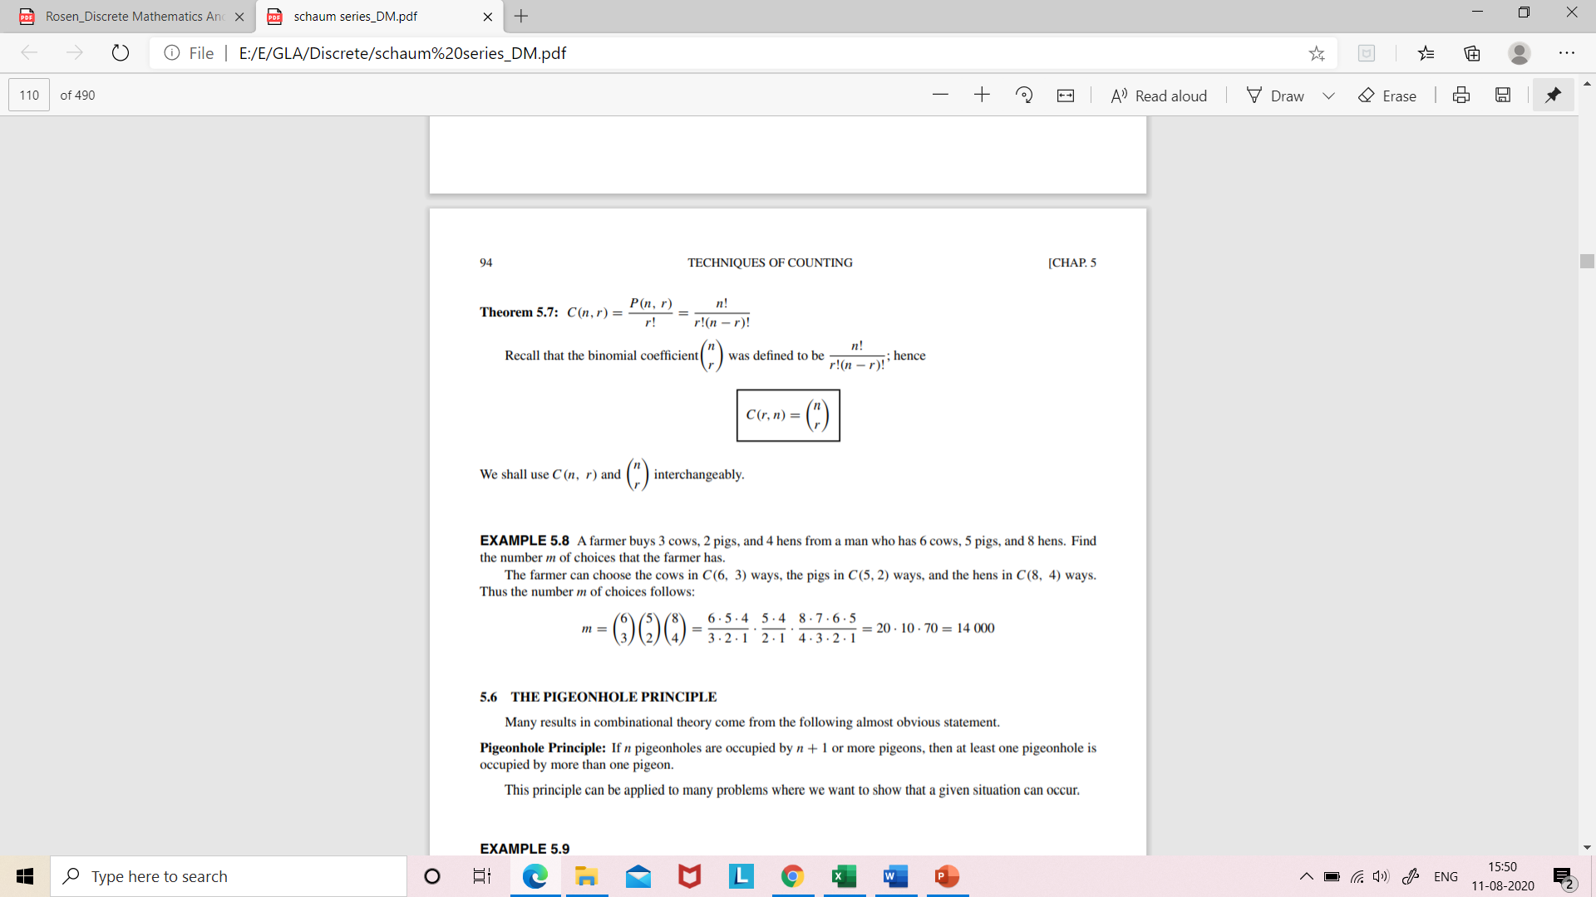
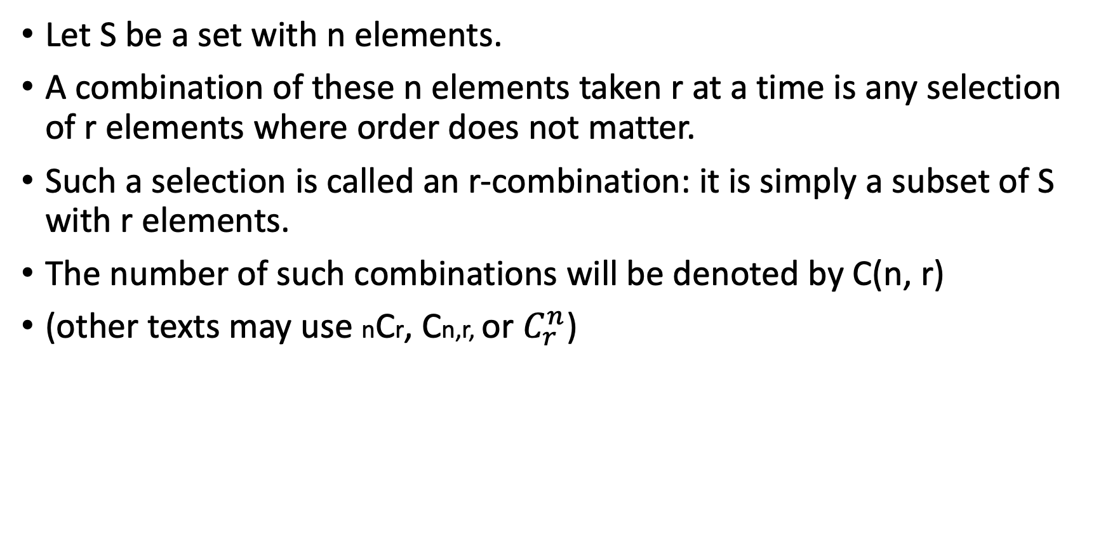
COMBINATIONS
Let S be a set with n elements.
A combination of these n elements taken r at a time is any selection of r elements where order does not matter.
Such a selection is called an r-combination: it is simply a subset of S with r elements.
The number of such combinations will be denoted by C(n, r)
(other texts may use nCr, Cn,r, or $C_{r}^{n}$)

Slide 4
Find the number of combinations of 4 objects, A, B, C, D, taken
3 at a time. Each combination of three objects determines
3! = 6 permutations of the objects as follows:
P (4, 3) = 4 · 3 · 2 = 24 and 3! = 6; hence C(4, 3) = 4

Slide 5

Example
A farmer buys 3 cows, 2 goats, and 4 hens from a man who has 6 cows, 5 goats, and 8 hens. Find the number of choices that the farmer has.
Solution
The farmer can choose the cows in C(6, 3) ways,
the goats in C(5, 2) ways,
and the hens in C(8, 4) ways.
Thus the number m of choices follows:

Slide 6
Example
Find the number of subsets of the set {1, 2, 3, 4, 5, 6, 7, 8, 9, 10, 11} having 4 elements.
We can do this by using the combination formula as:
¹¹ C ₄ = 11!/4!(11-4)!
= 11!/ 4!7!
= (11.10.9.8)/4.3.2.1
= 330 ways

Slide 7
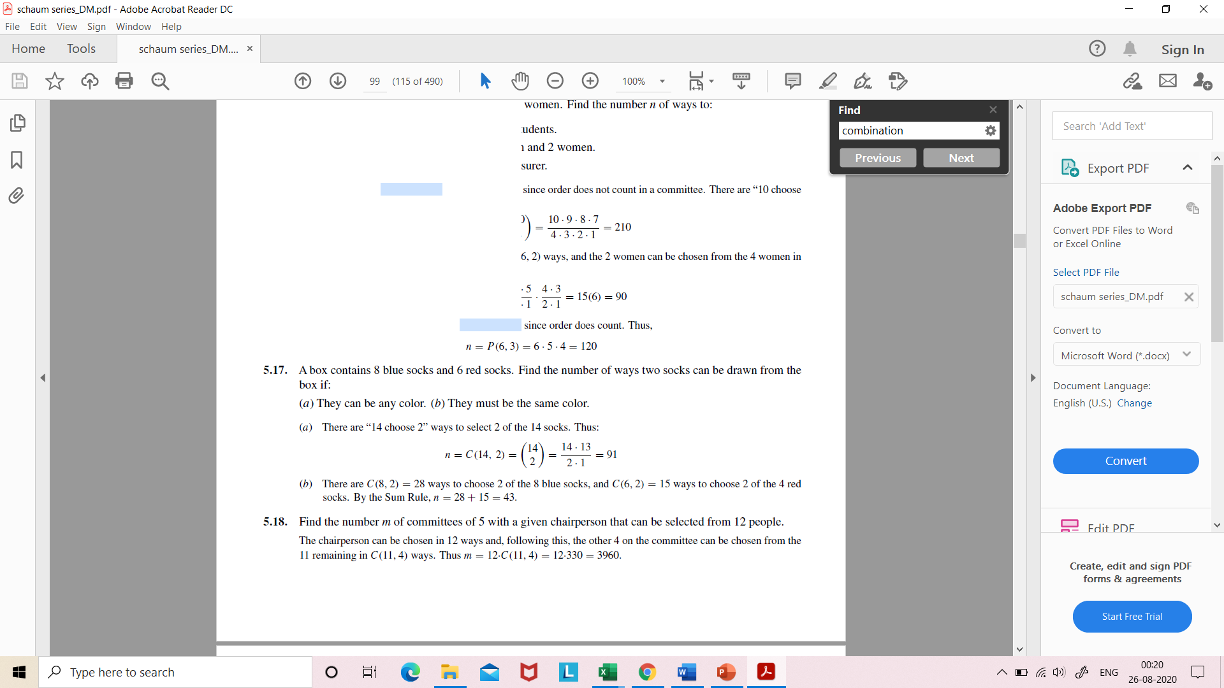
Example
A box contains 8 blue socks and 6 red socks. Find the number n of ways two socks can be drawn from the box if:
(a) They can be any color.
(b) They must be the same color.

Slide 8
Example
The Indian Cricket team consists of 16 players. It includes 2 wicketkeepers and 5 bowlers. In how many ways can you select a cricket team of 11 players if you have to select 1 wicketkeeper and at least 4 bowlers?
Case1: number of ways of selecting 1 wicket keeper, 4 bowlers and 6 other players =²C₁×⁵C₄×⁹C₆ = 840.
Case2: the number of ways of selecting 1 wicket keeper, 5 bowlers and 5 other players= ²C₁×⁵C₅×⁹C₅ = 252
Therefore, the total number of ways of selecting the team
= 840 + 252 = 1092.

Slide 9
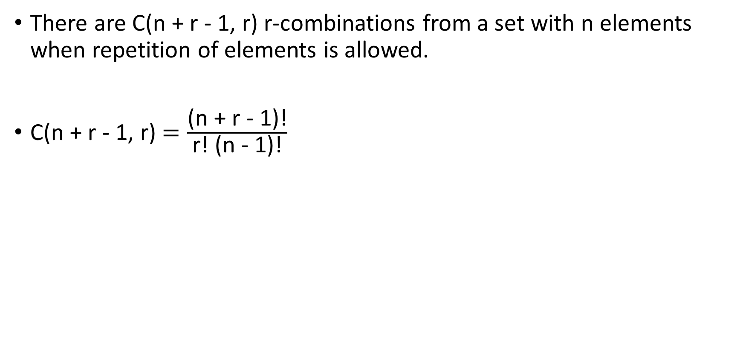
Combination with Repetition
There are C(n + r - 1, r) r-combinations from a set with n elements when repetition of elements is allowed.
C(n + r - 1, r) $=\frac{\text{(}\text{n}\text{ + }\text{r}\text{ − }\text{1)}\text{!}}{\text{r}\text{! (}\text{n}\text{ − }\text{1}\text{)!}}$

Slide 10
Example
Suppose that a cookie shop has 4 different kinds of cookies. How many different ways can 6 cookies be chosen? Assume that only the type of cookie, and not the individual cookies or the order in which they are chosen, matters.
Solution
The number of ways to choose 6 cookies is the number of
6-combinations of a set with 4 elements.
This equals C (4 + 6 - 1, 6) = C (9, 6) = 84
There are 84 different ways to choose the six cookies.

Slide 11
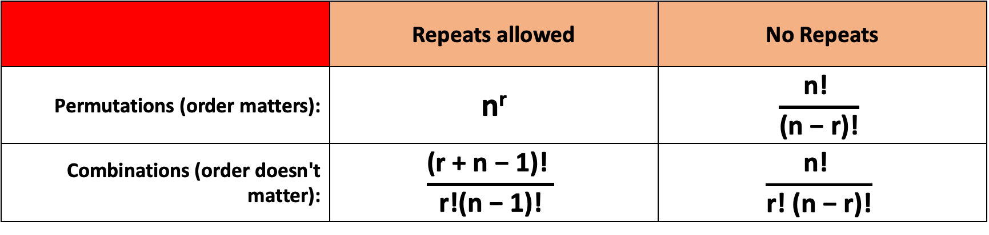
Conclusion
 | Repeats allowed | No Repeats
Permutations (order matters): | n^{r} | $$\frac{\text{n}\text{!} }{\text{(}\text{n}\text{ − }\text{r}\text{)!}}$$
Combinations (order doesn't matter): | $$\frac{\text{(}\text{r}\text{ + }\text{n}\text{ − 1)!} }{\text{r}\text{!(}\text{n}\text{ − 1)!}}$$ | $$\frac{\text{n}\text{!} }{\text{r}\text{!} \text{(}\text{n}\text{ − }\text{r}\text{)!}}$$

Slide 12
Practice Questions
In how many ways a committee of 5 members be selected from 6 men and 5 ladies consisting of 3 men and 2 ladies.
A committee of 5 is to be formed out of 6 men and 4 ladies. In how many ways this is done, when
(a) at least 2 ladies are included
(b)at most 2 ladies are included
From a group of 6 men and 4 women we have to choose a committee of 5 people. How many committees are possible if there are no restrictions?
A bangle shop sells 5 kinds of bangles. Find the number of ways a customer can buy: (a) 8 bangels; (b) a dozen bangels.

